Slide 1
Classes 21-24 Corporate finance
BEM 103
Class 21: The Corporation and decision rights
Class 22: Jerrel Watt, the practice of options
Class 23: Leveraged buyouts, taking firms private, Executive compensation
Class 24: Taxation and regulation

Slide 2
Class 21: The corporation
BEM 103
Decisions
Conflicts within the firm
Decision rights
Financial claims as decision rights
Financial engineering

Slide 3
Key concepts
Decision rights
Income rights
Corporate form
Return to effort
Public vs private firms
Debt equity ratio
Equity as an option

Slide 4
The firm (Ec 11 review)
A firm is
a collection of inputs
Capital, labor, raw materials, energy.
a production rule
Technology that combines inputs into outputs
Monitoring Technologies
Management has to make sure the work gets done
Investors want to make sure that the firm makes a return
Finance help design incentives within the firm

Slide 5
The firm as hierarchy
“Workers”
Everyone in the firm helps make it profitable
Effort is costly, it has to be induced
Salaries and monitoring (management)
Profit sharing?
Stock options
bonuses
Management
Effort is costly
Has to be allocated to monitoring and to investment decisions.
How to structure the firm’s balance sheet to induce the right kind of effort?

Slide 6
Organizing the firm
Choice of form
Corporation (public and private)
Other Limited liability forms
Choice of debt and equity
Conditional on capital what does more debt do?
Choice of voting rights
Common vs preferred stock
Note this leaves out options and other compensation directly to individual (Friday’s lecture)

Slide 7
Organizational form
Ordinary Partnerships
Unlimited liability, joint management, at will
Primary problem untimely dissolution
Partner withdraws, dies or strategic conflict
Then have to sell assets at a loss
One-share One-vote Corporations
Limited liability, delegated management, investment locked in
Firm exists ‘independently ’ of its owners
Primary problem is minority oppression. Whomever is in control makes the strategic decisions for the form

Slide 8
Organizational forms

Slide 9
Nearly all firms are private
C Corporation is the standard form
Publicly traded Corporations are C-Corps
Tax reforms of the Ronald Reagan era
Drop in marginal rate of income taxation
More firms created as something other than a C corporations
Contractual innovation makes standard partnership less attractive
General Partnerships are a minority of like forms
Non corporate form popular
Very few firms face the discipline of the secondary market

Slide 10
Income Rights
Innovation of the corporation
Joint stock, lock-in of capital
Investors have income rights
Suppliers come first (including labor)
Debt holders
Senior claims (paid before equity)
Interest before dividends
Secured bond must be paid first
Equity holders are residual claimants
Dividends
Net liquidation value

Slide 11
Decision rights
Shareholder’s meetings (votes)
Elect board of directors
Major capital changes
Mergers and acquisitions
Secondary equity issues
Changes in bylaws
Between meetings
board of directors choses management
management
Debt holder has no decision rights
As long as the firm has a positive liquidation value
If not then debt holders in control.

Slide 12
Corporate finance (Jensen and Meckling 1976, Theory of the firm: Managerial behavior, agency costs and ownership structure)
Friedman doctrine
Goal of the firm is to maximize shareholder value
J&M
Need to align the incentives of management to the goals of the shareholders
Avoid shirking
Avoid extraction of private benefits
Corporate finance does that.

Slide 13
Allocating Income and decision rights
Choices
Debt vs Equity
Claim: more debt creates more focus on meeting return target.
Dividends vs retained earnings
Claim: more retained earnings means management more independent of market.
Common stock vs multiple classes of shares
Claim: less common stock implies control group more independent of investors
All affect both effort and project selection

Slide 14
Debt Equity levels and incentives
Two owners,
Equity financing
one majority owner (51%) each invests ±100.
desired return 240
Depends on effort of Manager (unpaid)

Slide 15
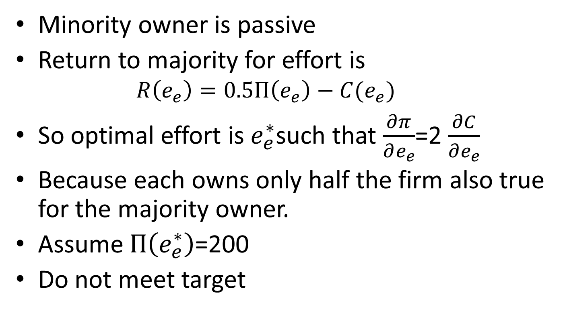
Setting effort
Minority owner is passive
Return to majority for effort is
$$R\left(e_{e}\right)=0.5Π\left(e_{e}\right)−C(e_{e})$$
So optimal effort is $e_{e}^{∗}$such that $\frac{∂π}{∂e_{e}}$=2 $\frac{∂C}{∂e_{e}}$
Because each owns only half the firm also true for the majority owner.
Assume $Π\left(e_{e}^{∗}\right)$=200
Do not meet target

Slide 16
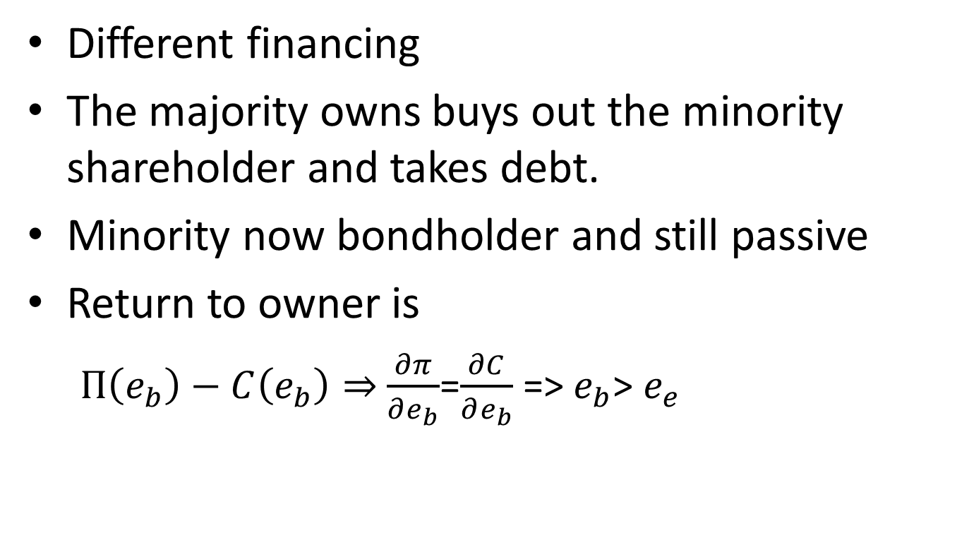
Changing financing
Different financing
The majority owns buys out the minority shareholder and takes debt.
Minority now bondholder and still passive
Return to owner is
$Π\left(e_{b}\right)−C\left(e_{b}\right)⇒$ $\frac{∂π}{∂e_{b}}$=$\frac{∂C}{∂e_{b}}$ => $e_{b}$> $e_{e}$

Slide 17
Debt Equity levels and incentives
Two effects
The owner’s return slope is steeper (gets all the return to effort)
Has to make b(1+r) to get anything
Both induce effort
Second effort can also induce risk taking
Because the owner here has a call option on the firm at b(1+r)

Slide 18
Practical implication
Equity holders may vote to take on debt
Simply because it forces managers to work harder
Of course, if it does not work they will face losses
Leveraged buyout
solution to underperforming firms
Key here is that managers must have skills such that effort produces value.
More on LBO next time

Slide 19
Debt and equity and control
Two key effects
Holding total capital constant
More debt makes the decision more aggressive.
More debt concentrates decisions making rights
Impact on project selection
+debt => select high-risk high-return projects
+debt => higher failure rates
Impact on investment rates (not clear)

Slide 20
Debt, equity and project selection
Famous paper (Modigliani Miller) made the argument that debt and equity are irrelevant to the value of the firm.
An arbitrage argument that assumes that debt and equity are irrelevant to any incentives
Debt and equity affect project selection
Again intuition is that equity holders have a call option on the upside and a put option on the downside (where the strike price is the value of the bonds)
So equity holders ‘like’ risk

Slide 21
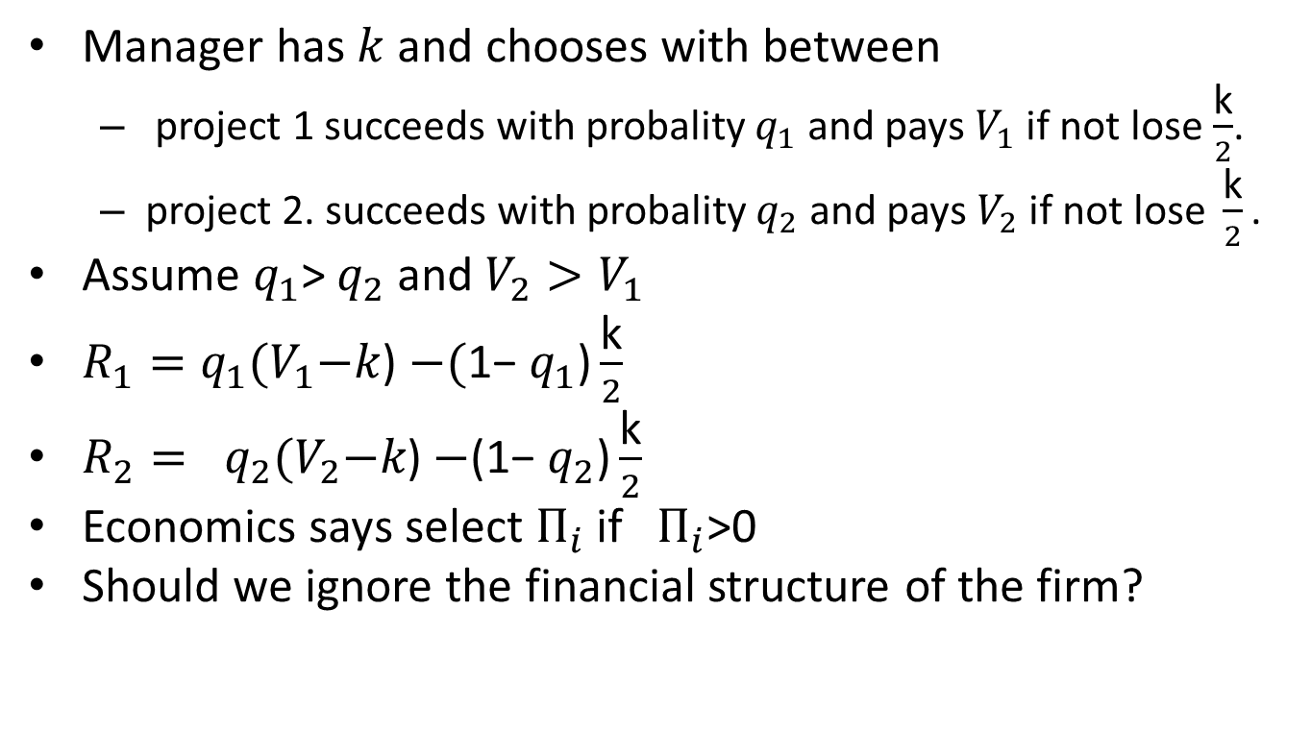
Project selection
Manager has $k$and chooses with between
project 1 succeeds with probality $q_{1}$ and pays $V_{1}$ if not lose $\frac{\text{k}}{2}$.
project 2. succeeds with probality $q_{2}$ and pays $V_{2} \text{if} \text{not} \text{lose} \frac{\text{k}}{2}\text{.}$
Assume $q_{1}$> $q_{2}$ and $V_{2}>V_{1}$
$R_{1}=q_{1}{(V}_{1}−k$) $−\text{(}\text{1−} q_{1}\text{)}\frac{\text{k}}{2}$
$R_{2}= q_{2}{(V}_{2}−k\text{) }$ $−\text{(1−} q_{2}\text{)}\frac{\text{k}}{2}$
Economics says select $Π_{i}$ if $Π_{i}$>0
Should we ignore the financial structure of the firm?

Slide 22
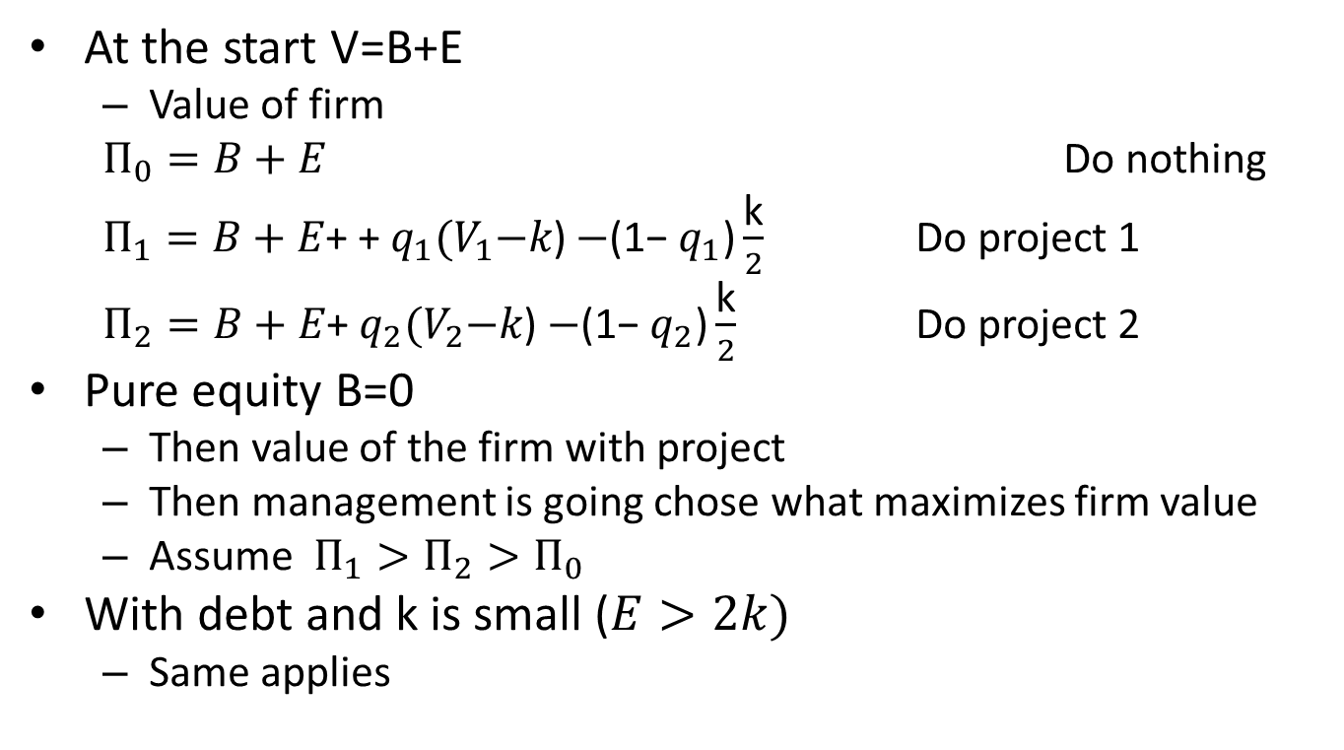
Debt and equity and project selection
At the start V=B+E
Value of firm
$Π_{0}=B+E$ Do nothing
$Π_{1}=B+E\text{+} \text{+} q_{1}{(V}_{1}−k\text{)}$ $−\text{(1−} q_{1}\text{)}\frac{\text{k}}{2}$ Do project 1
$Π_{2}=B+E\text{+} q_{2}{(V}_{2}−k\text{) }$ $−\text{(1−} q_{2}\text{)}\frac{\text{k}}{2}$ Do project 2
Pure equity B=0
Then value of the firm with project
Then management is going chose what maximizes firm value
Assume $Π_{1}>Π_{2}>Π_{0}$
With debt and k is small ($E>2k)$
Same applies

Slide 23
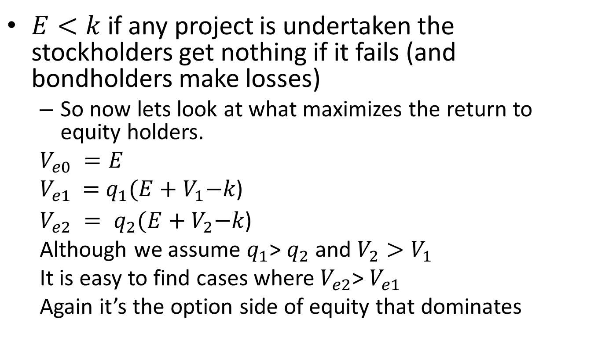
Debt and equity and project selection
$E<k$ if any project is undertaken the stockholders get nothing if it fails (and bondholders make losses)
So now lets look at what maximizes the return to equity holders.
$V_{e0} =E$
$V_{e1}\text{ =} q_{1}{(E+V}_{1}−k\text{)}$
$V_{e2} = q_{2}{(E+V}_{2}−k\text{) }$
Although we assume $q_{1}$> $q_{2}$ and $V_{2}>V_{1}$
It is easy to find cases where $V_{e2}$> $V_{e1}$
Again it’s the option side of equity that dominates

Slide 24
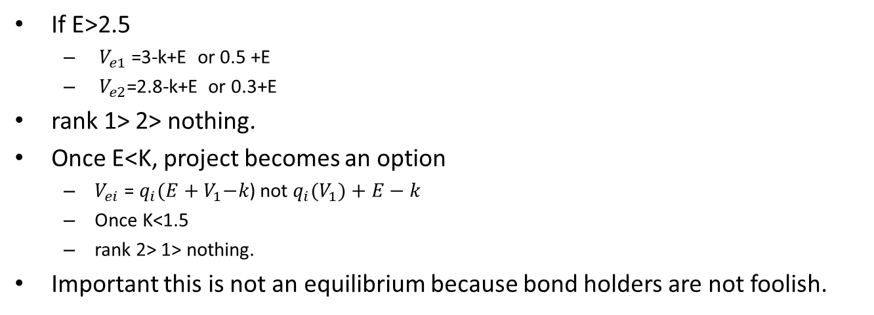
If E>2.5
$V_{e1}$=3-k+E or 0.5 +E
${ V}_{e2}$=2.8-k+E or 0.3+E
rank 1> 2> nothing.
Once E<K, project becomes an option
$V_{ei}$= $q_{i}{(E+V}_{1}−k\text{)}$ not $q_{i}{(V}_{1})+E−k$
Once K<1.5
rank 2> 1> nothing.
Important this is not an equilibrium because bond holders are not foolish.

Slide 25
Empirical content
Gambling for resurrection
As equity value declines, equity holders favor more risk (this is a particularly true when the equity is negative)
Historically
Secondary offerings of equity after IPO are rare.
Bond offerings were frequent
In recent years reversal
Secondary offerings have become more frequent

Slide 26
Part 2 Public versus private

Slide 27
Number of listed companies and secondary offerings
Source: Jay Ritter website (CRSP)

Slide 29
Corporate Engineering
Issue equity, but it does not have to all be the same.
Departures from one share one vote
Preferred shares,
Non-voting, guaranteed dividend. Failure to pay implies become common stock (who holds the option!)
Convertible debt (important in venture capital)
If start up is a success, VC converts to equity and shares in the profits
If start up is struggles, VC calls the bonds and takes over the firm
Entrepreneur is in control only if the firm is doing well
Multiple classes of voting stock
Rare in US before 1970. (exceptions Ford, Wall Street Journal)
Common in Scandinavia (founders get shares with 10 votes).
Become more frequent in the US after the Google IPO

Slide 30
https://site.warrington.ufl.edu/ritter/files/IPOs-Dual-Class.pdf

Slide 31
An example
Alphabet, Google’s parent company, has two listed share classes that use slightly different ticker symbols.
2.99 Billion Class A shares (GOOGL), have one-vote.
3.46 Billion Class C shares (GOOG) have no voting rights.
Because of their voting rights, A shares may trade at a premium to C shares; however, in reality, the prices of the two are often quite close to one another.
465 Million Class B shares, which are held by founders and insiders and confer 10 votes per share. Class B shares can’t be publicly traded.
Class B shares have twice the votes of the common stock. The founders have complete control

Slide 33
Why is control important?
Decisions about compensation of key employes (Stock options; golden parachutes)
Decisions about the distribution of returns or reinvestment.
Decisions about investment plans.
Key to IT firms but also key to many past firms.
Next LBOs and executive compensation

